Slide 1
Welcome to Year One

Slide 2
Year One Staff
Class Teacher: Miss Joseph
Teaching Assistants: Mrs Chalk and Mrs Kiely

Slide 3
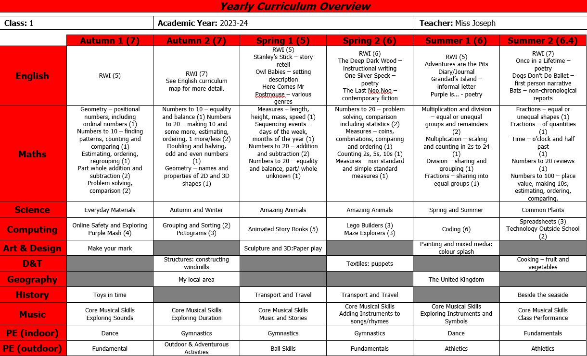
Curriculum Overview

Slide 4
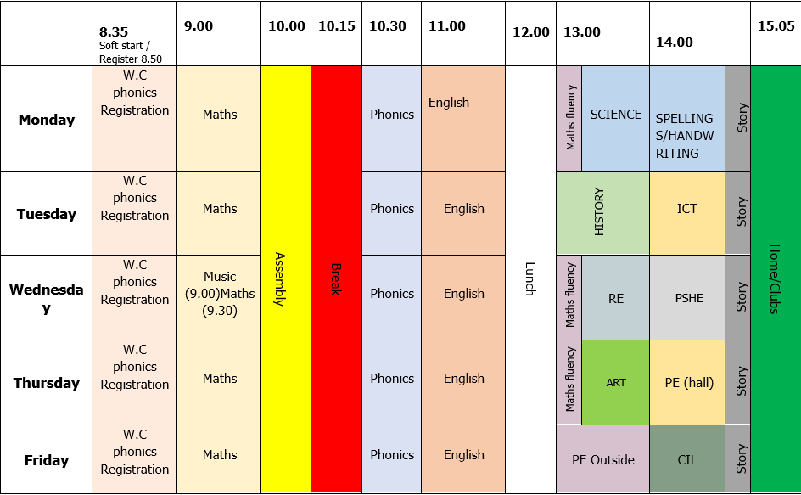
Timetable

Slide 5
What does a Year One learner look like in English/Phonics?
In Phonics lessons, children are taught reading and writing skills through the Read Write Inc scheme. The children are taught the sounds that individual and groups of letters make, and how to blend these together to read and spell words. They will further develop these skills by learning how to write simple sentences and punctuating them correctly. By the end of Year One, children should have a good understanding of how to use spelling rules, such as adding –ed or –ing to words, as well as joining sentences with conjunctions such as and.

Slide 6
What does a Year One learner look like in Maths?
By the end of Year One, children will talk about their mathematics using the numbers they are familiar with, applying their understanding of number, measures and shape to a greater range of problems. Children will be expected to prove their thinking through pictures, jottings and conversations. They will be encouraged to use concrete manipulatives to help them solve problems and build their understanding of number.

Slide 7
Statutory assessments: Phonics screening.
Each year, children in Year One are assessed on their phonic knowledge. This will take place in the Summer Term.
How does the check work?
Your child will sit with a teacher he or she knows and be asked to read 40 words aloud.
Your child may have read some of the words before, while others will be completely new.
The check normally takes just a few minutes to complete and there is no time limit. If your child is struggling, the teacher will stop the check. The check is carefully designed not to be stressful for your child.

Slide 8
Home Learning Expectations - Reading
The expectation is that your child reads to an adult each day for approximately 10 minutes.
This needs to be recorded in the Reading Record and signed by and adult. Any comments you make are very helpful.
The children will bring home a copy of the text from their RWI group as well as another book at the same level. They will also have the opportunity to bring home a library book of their choice, if they wish,

Slide 9
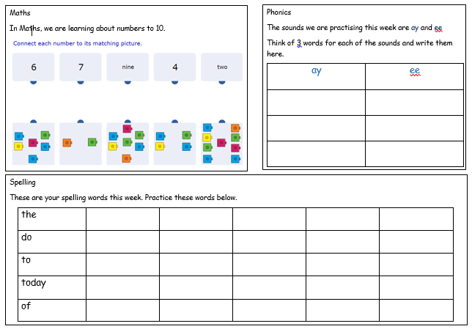
Home learning – Maths and spelling.
Home learning will be set up on Google Classroom and MyMaths. However, I will always make paper copies to send home for Year 1 children.

Slide 10
Home Learning – Numbots/Times Tables
By the end of Year One, children should be able to count in multiples of 2, 5 and 10. It would really benefit the children to rehearse these for a few minutes, daily. Each child has been given their Numbots/TTRockstars login. Please feel free to login with your child and familiarise yourselves with the app.

Slide 11
Behaviour and Expectations
High expectations
Learning superpowers
Resilience
Curiosity
Collaboration
Reflective
Empathy
Resourcefulness

Slide 12
Additional Information
P.E. kit – Please ensure that your child brings their PE kit to school in a bag on Mondays. Our PE days are Thursday and Friday.
If your child has pierced ears, please ensure they are wearing small studs.
If your child’s hair is shoulder length (or longer), please ensure that your child’s hair is tied up.
Water bottles
Fruit/vegetables

Slide 13
Medical needs
If your child has any medication we should have in school, please make sure we have them.

Slide 14
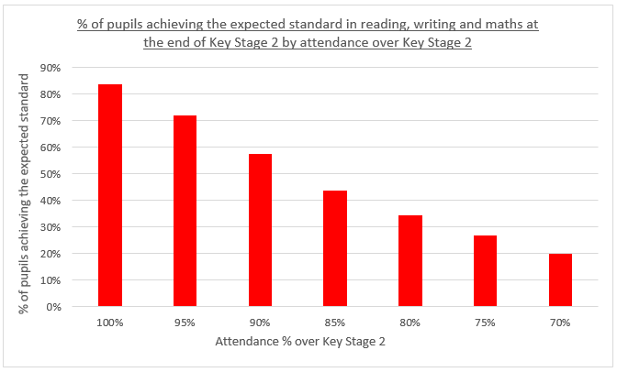
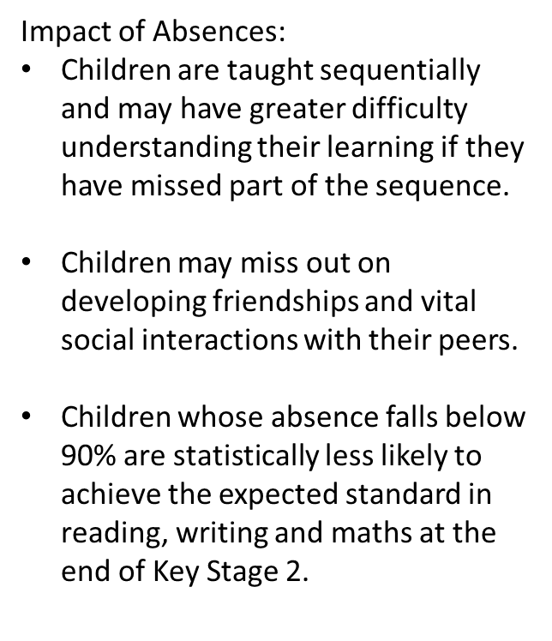

Slide 16
Website – Class Pages
Overviews
Timetables
Class newsletter
Photographs (consent)

Slide 17
Finally…
Thank you for coming along today!
I am always happy to answer any queries (preferably at the end of the day once all the children have been dismissed).
Sign up for pupil premium.
Any questions?

