Slide 1

Welcome to Birchwood Avenue Primary School
Educating Hearts and Minds

Slide 2
Mission Statement
Our mission statements and goals are:
To nurture and motivate lifelong learners with a curiosity about the world around them.
To work in partnership with parents, carers and the wider community.
To provide a range of stimulating and memorable experiences.
To value and respect the diversity of our communities.
To deliver a rich, challenging and creative curriculum tailored to the needs of the individual.
To collaborate with a range of extended services to support the Birchwood family.

Slide 3

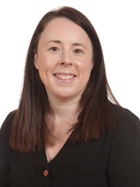
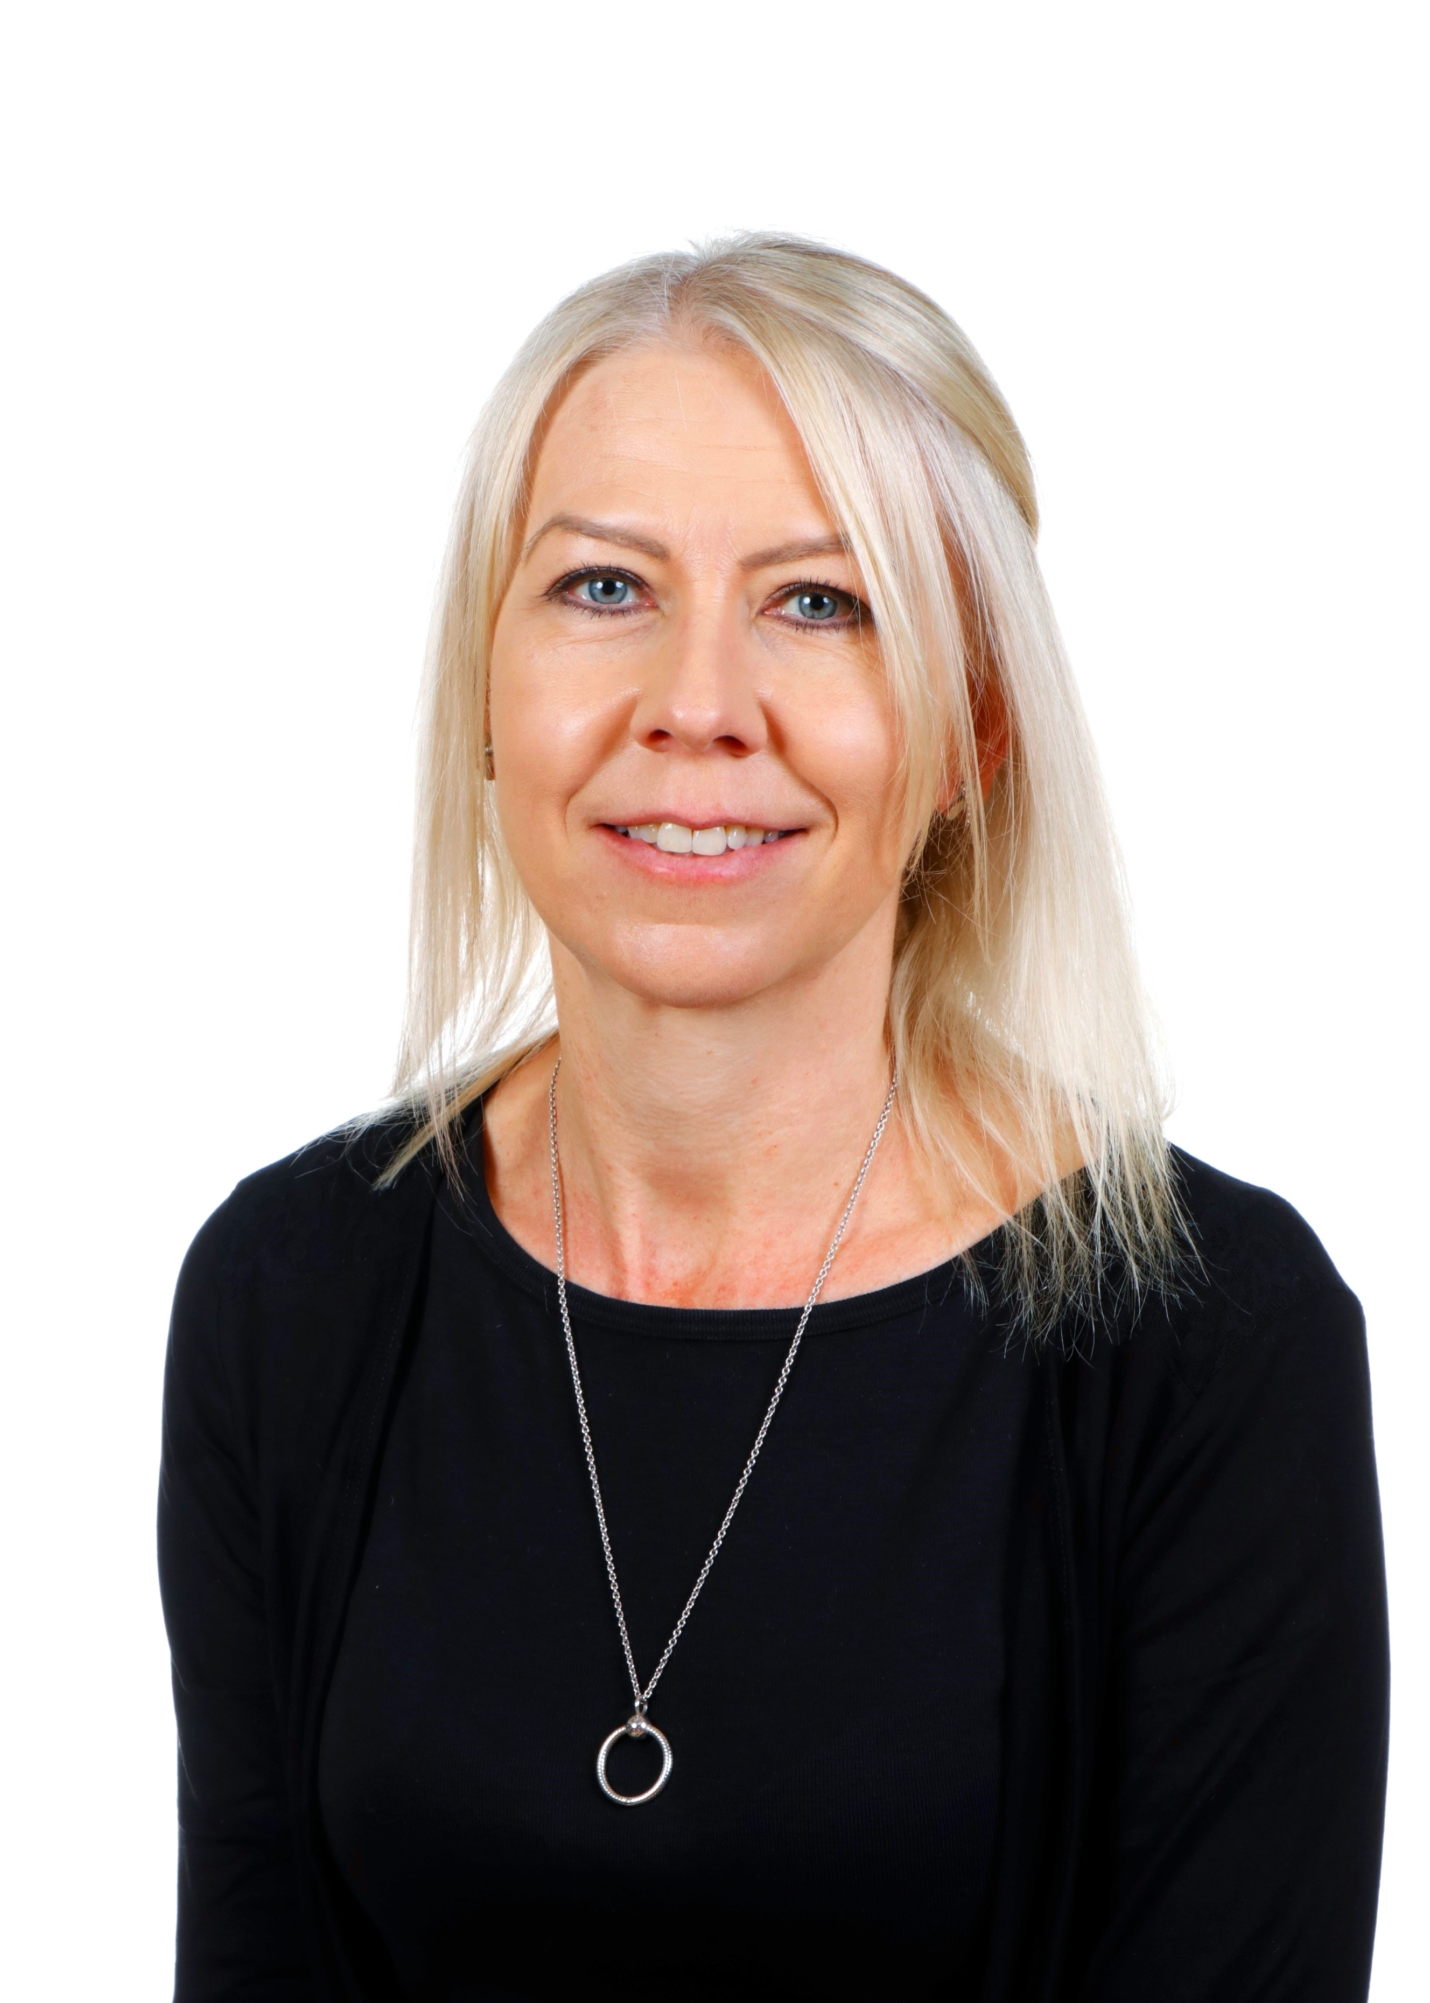
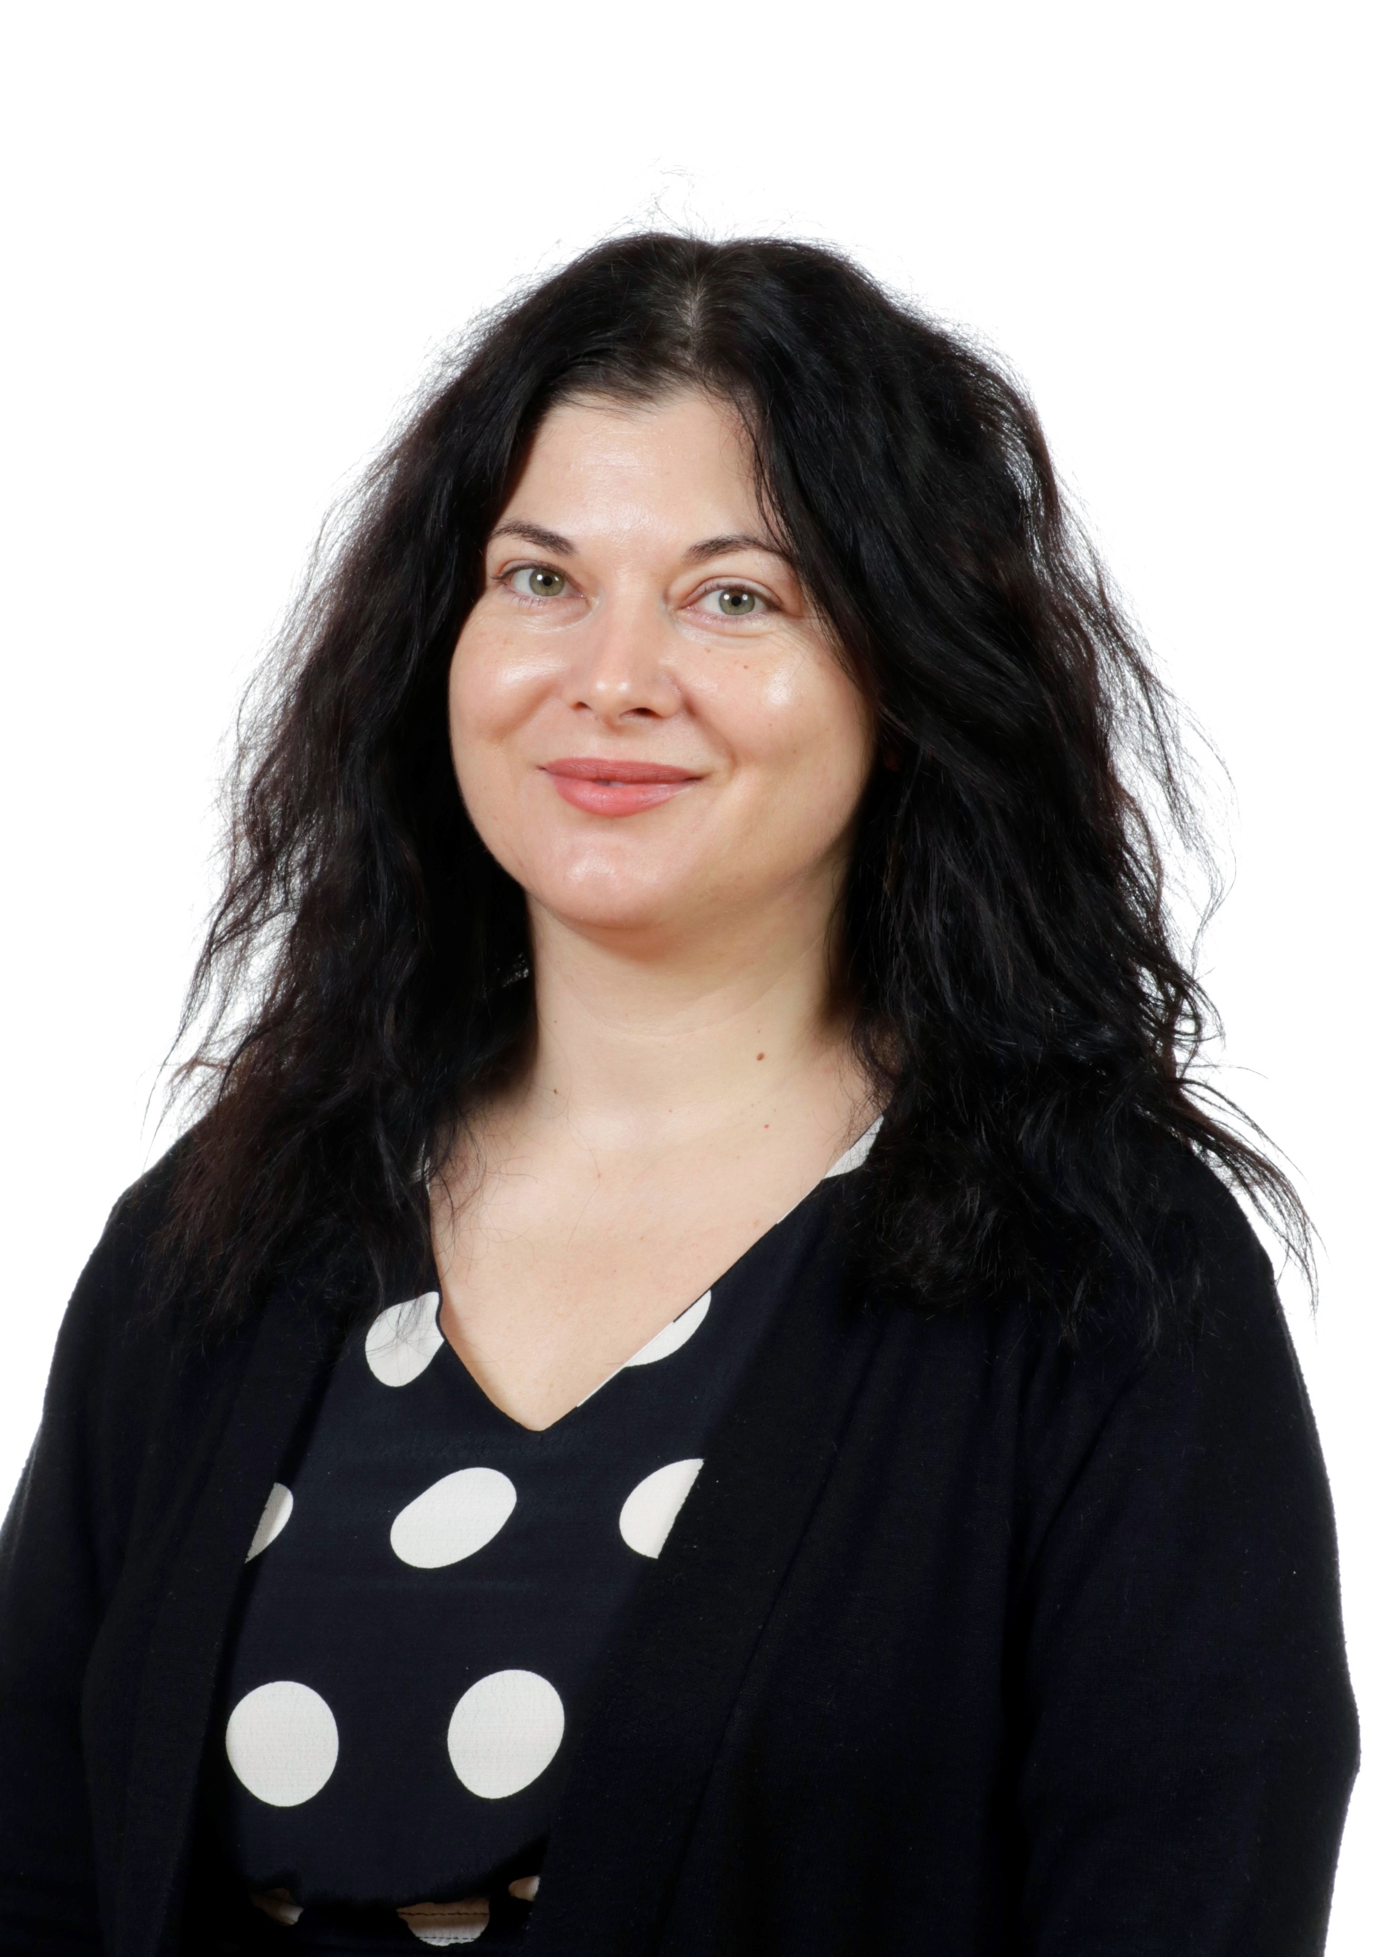
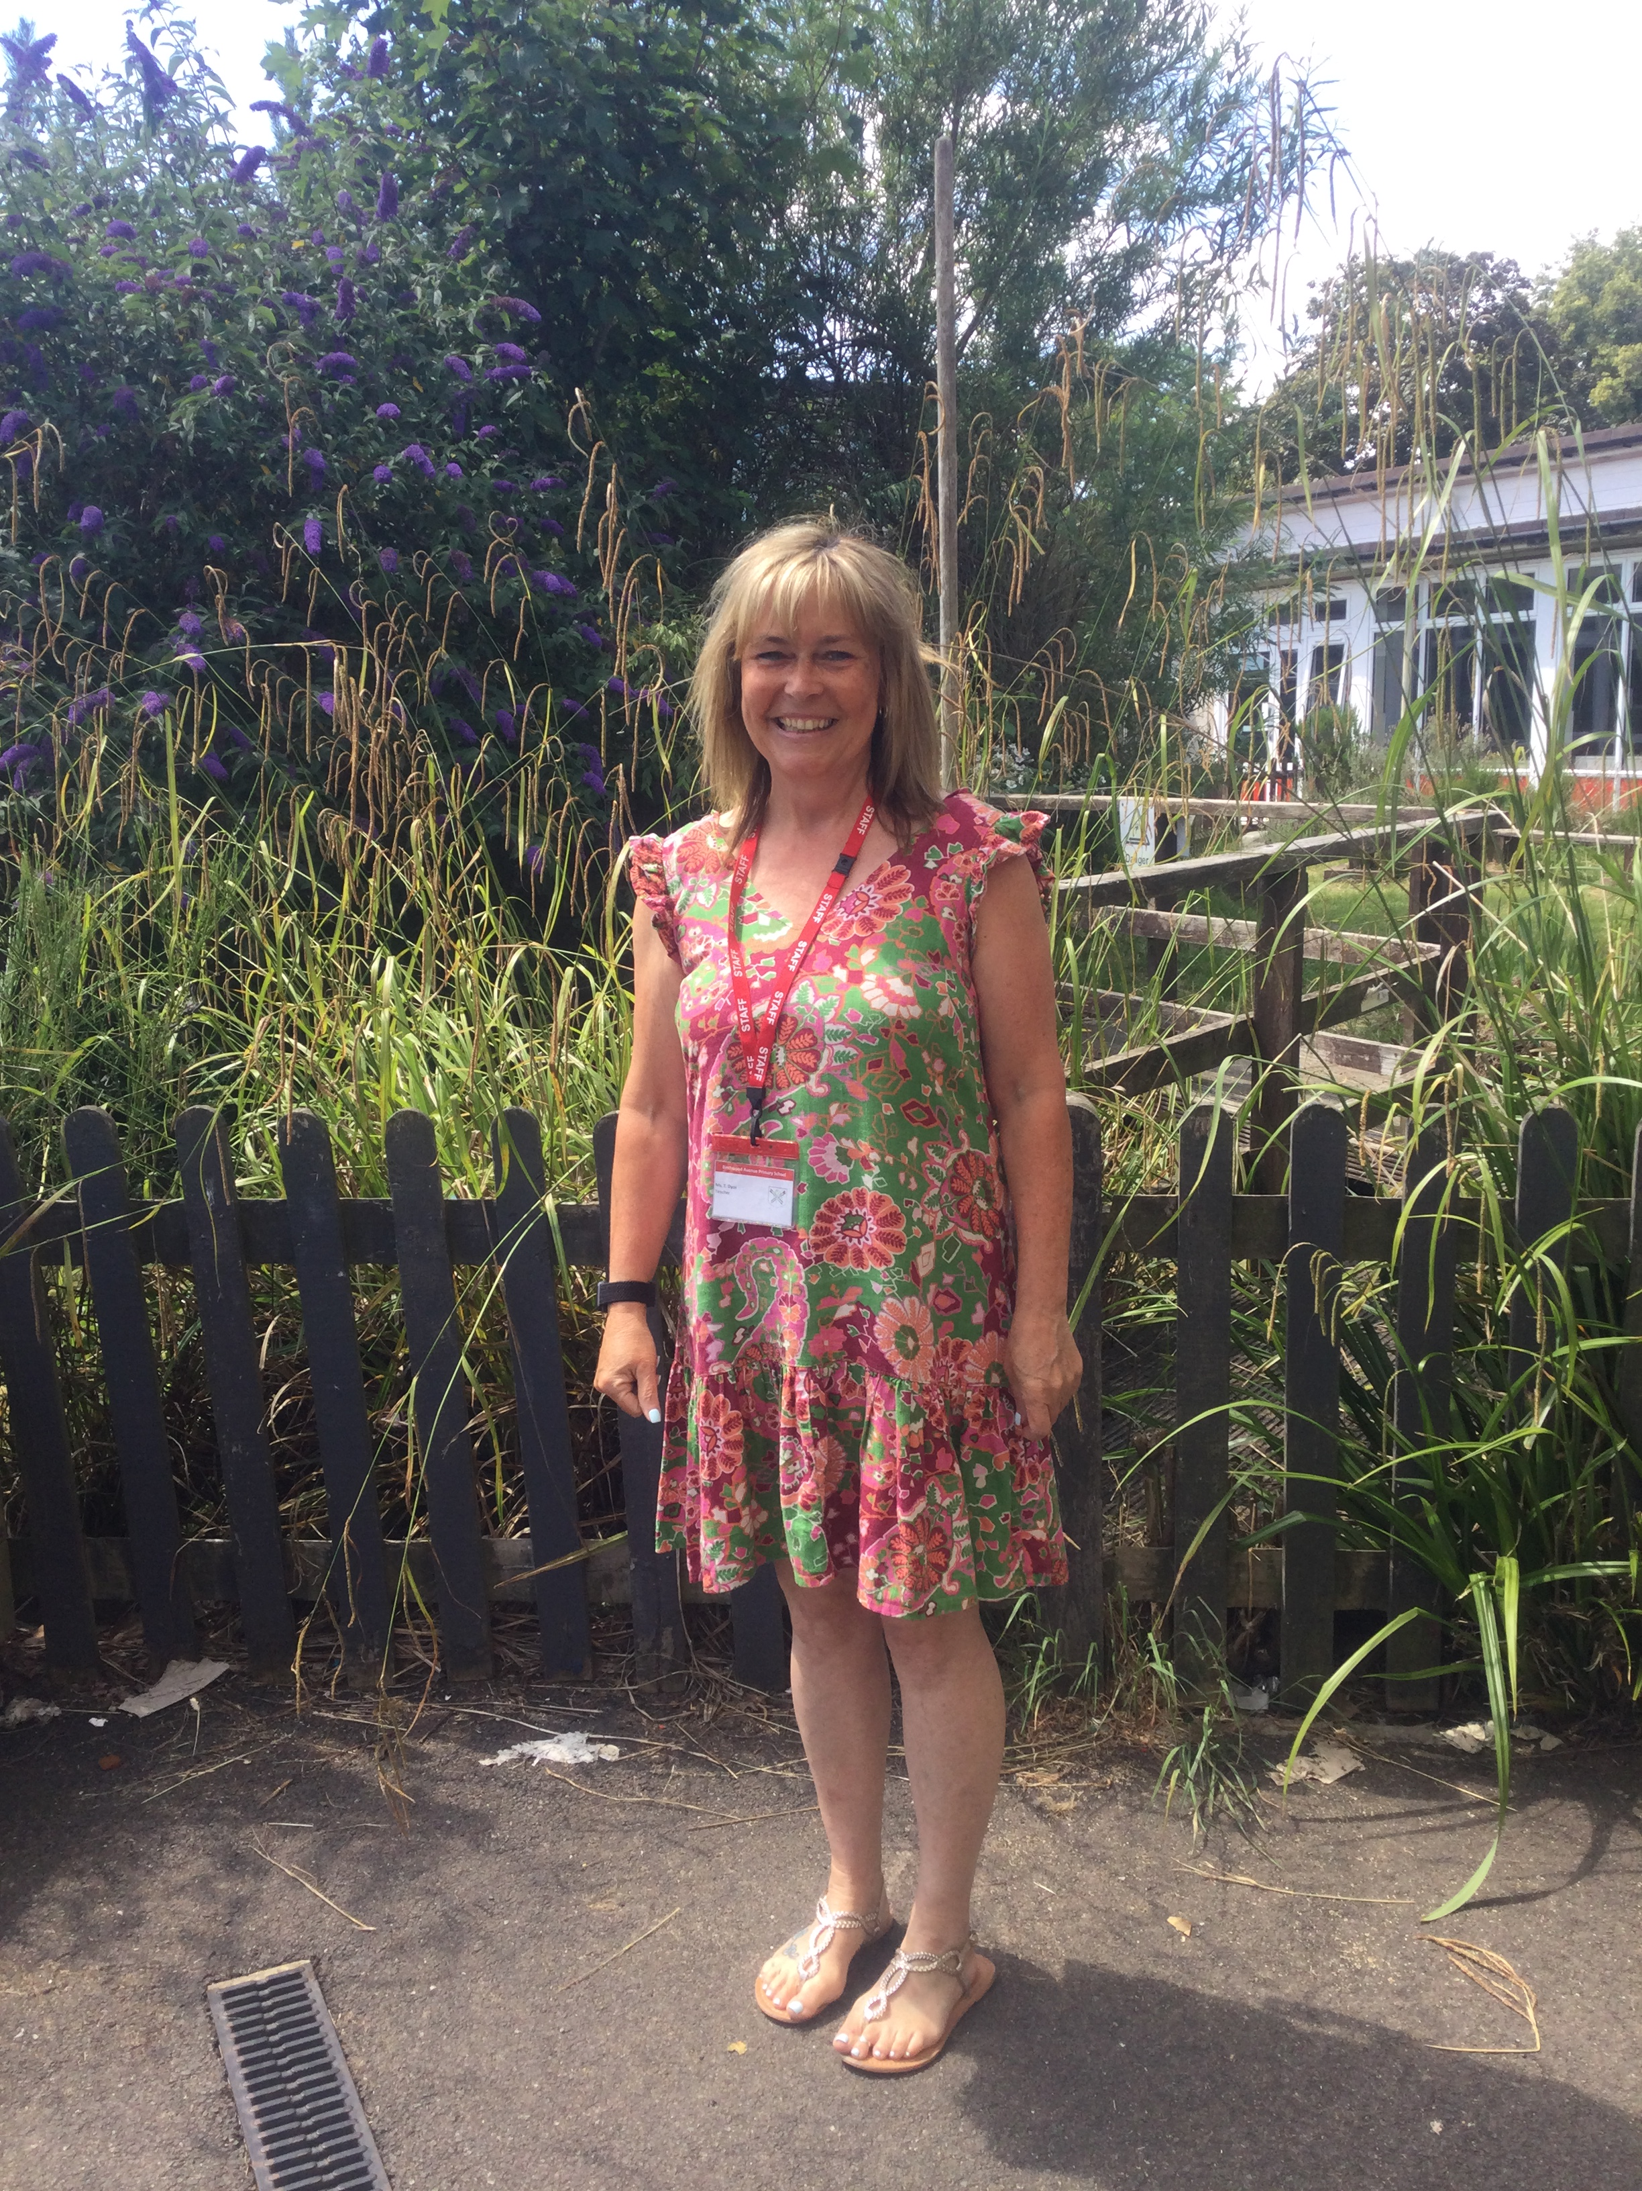
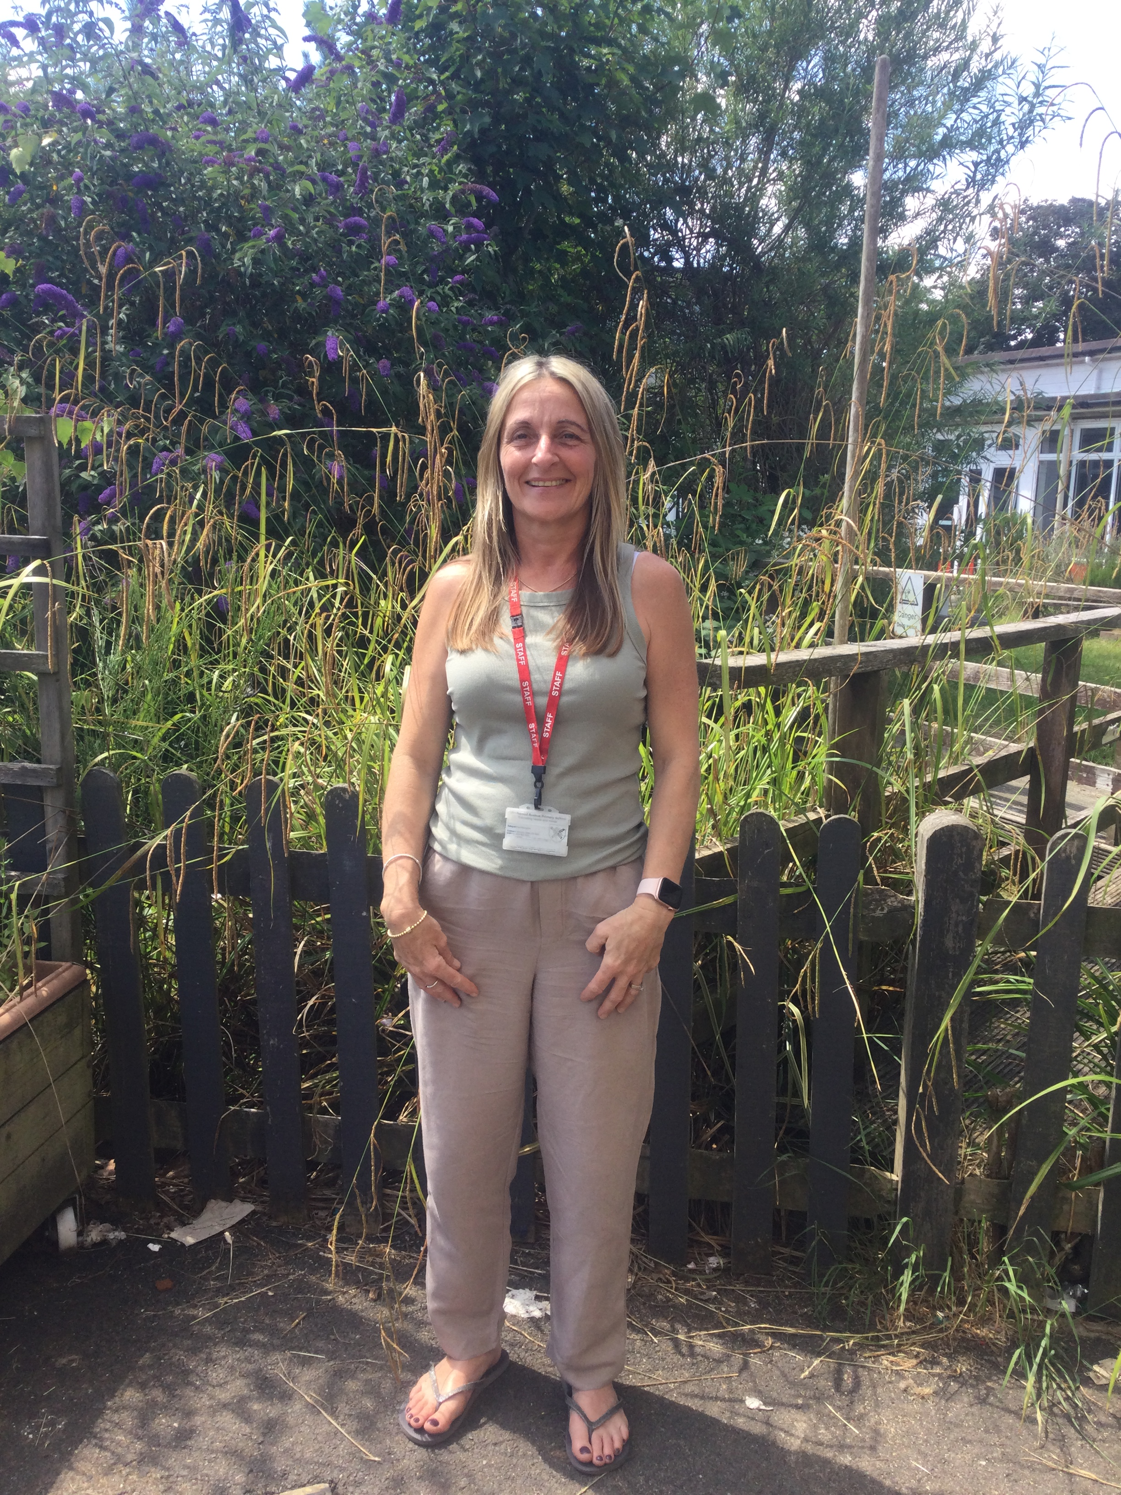
Important Staff for Reception
Senior Leadership Team
Headteacher: Miss Hall
Deputy Head: Miss James (SENCo)
Assistant Head/EYFS Leader: Ms K Swash
Reception Staff
Class Teacher: Mrs Dyos
Early Years Practitioners
Miss Hall
Miss James
Ms Swash
Miss Evans
Mrs Cristia
Mrs Chalk

Slide 4
Communication and Payments
All communications are sent via email/text message
School Arbor
Ensure mobile numbers and email addresses are up to date
Cashless system

Slide 5
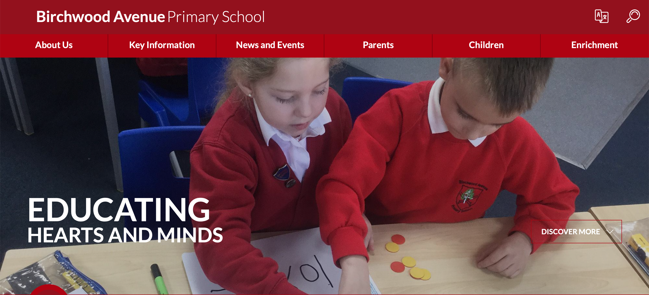
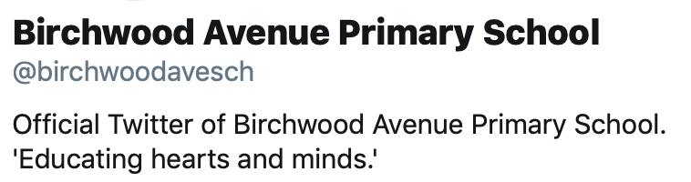
School Website and Twitter
Past letters
Newsletters
Term dates
Calendar dates
Updates about learning

Slide 6
Free School Meals
Recommend that everybody registers, irrelevant of income
It takes minutes to register and could benefit both your family and the school
www.hertfordshire.gov.uk/freeschoolmeals

Slide 7
Safeguarding
Safeguarding and promoting the welfare of children is everyone’s responsibility
The School has a legal duty to refer any concerns to Children’s Services
Schools and their staff form part of the wider safeguarding system for children. This system is based on the principle of providing help for families to stay together where it is safe for the children to do so, whilst acting in the best interests of the child
Child Protection Policy on website
Tips in the newsletter
Designated Senior Leads: Miss Hall, Ms Swash and Miss James

Slide 8

Friends of Birchwood (FOB)
Events
Refreshments
Raises money for the school
Can you help?
fob@birchwoodavenue.herts.sch.uk
Friends of Birchwood on Facebook

Slide 9

A Typical Day in Reception
8:35 - Playground gate opens
8:35 – 8:50 - Busy Fingers
8:50 - 9:00 - Morning Registration
9:00 - 9:15 - Welcome Songs and Story
9:15 - 9:45 – Phonics Session
9:45 – 11:15 – Child Initiated Learning (CIL)
(10:00 - 11:00 Rolling Snack)
11:20 – Math
11:40 Songs, Red words
12pm Lunchtime
13:00 - Afternoon Registration
13:05 – Dough Disco and Story
13:15 – Theme Lesson
13:30 - 14:40 Child Initiated Learning (CIL)
14:40 - 14:50 - Story Time
14:50 - 15:05 - Getting Ready for Home

Slide 10
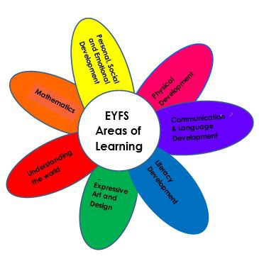
Areas of Learning
Prime Areas
Communication and Language
Physical Development
Personal, Social and Emotional Development
Specific Areas
Literacy
Mathematics
Understanding the World
Expressive Arts and Design

Slide 11
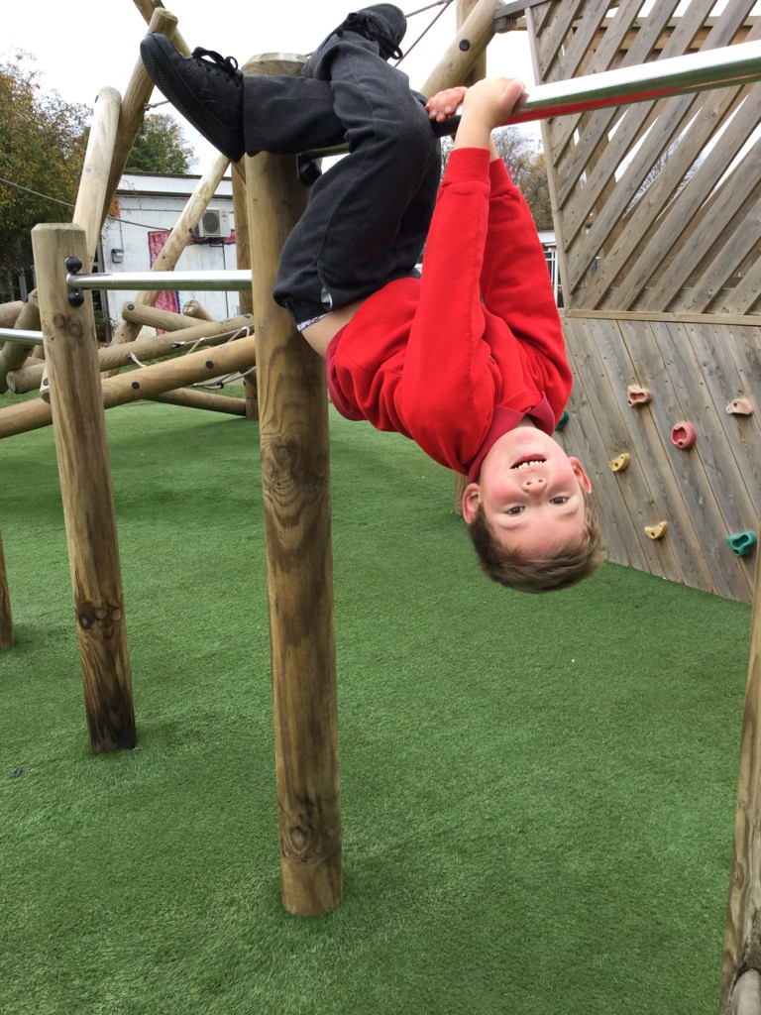
Effective Learning in Reception
The ways in which children engage with other people and their environment (playing and exploring, active learning, and creating and thinking critically) underpin learning and development across all areas and support the child to remain an effective and motivated learner.
Learning through play is an important part of the daily routine.
Play is well-planned by staff to ensure children are developing their skills and knowledge across all areas of learning. We adapt our provision to reflect the needs and interests of the class.
Throughout the day there is an emphasis on language acquisition.
Talk is vital to support learning, and it is weaved through everything
we do.

Slide 12
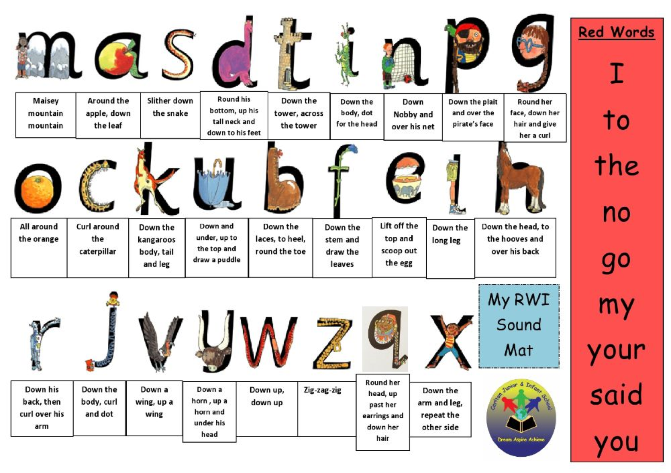
Reading
Children in Reception use phonics to learn to read. Please help them by using letter sounds not letter names.
We follow the Read, Write Inc. phonics scheme.

Slide 13



Reading at Home

Slide 14
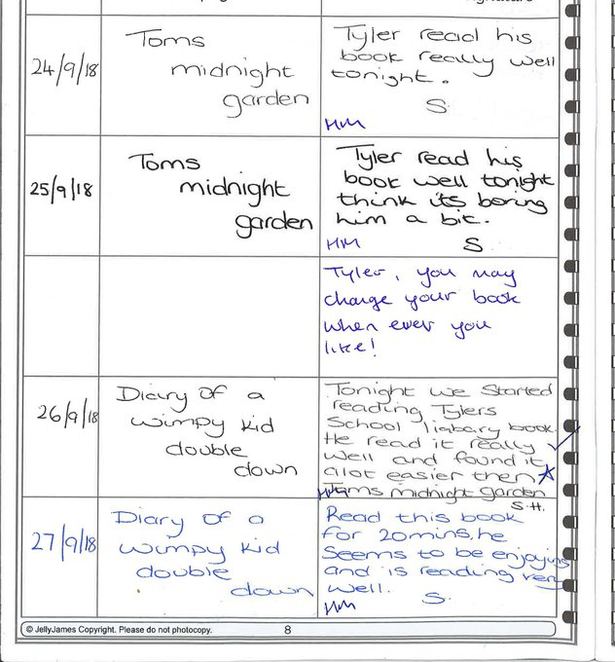

Reading Records
Write a short note or signature to let your class teacher know you have read at home with your child – include what they did well and anything they found tricky

